Slide 1
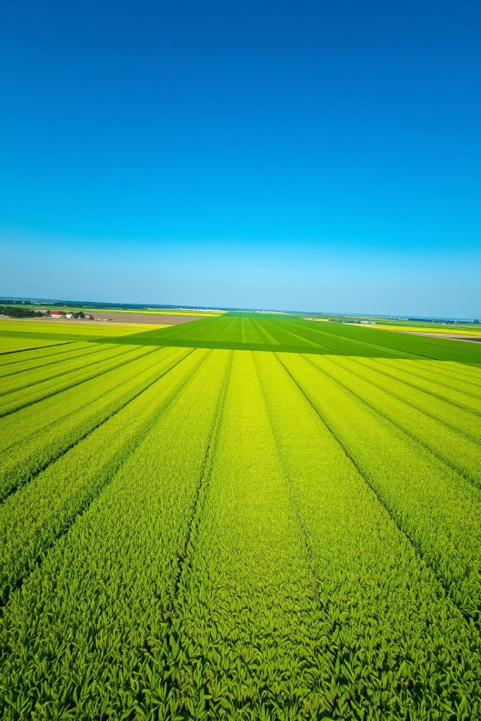
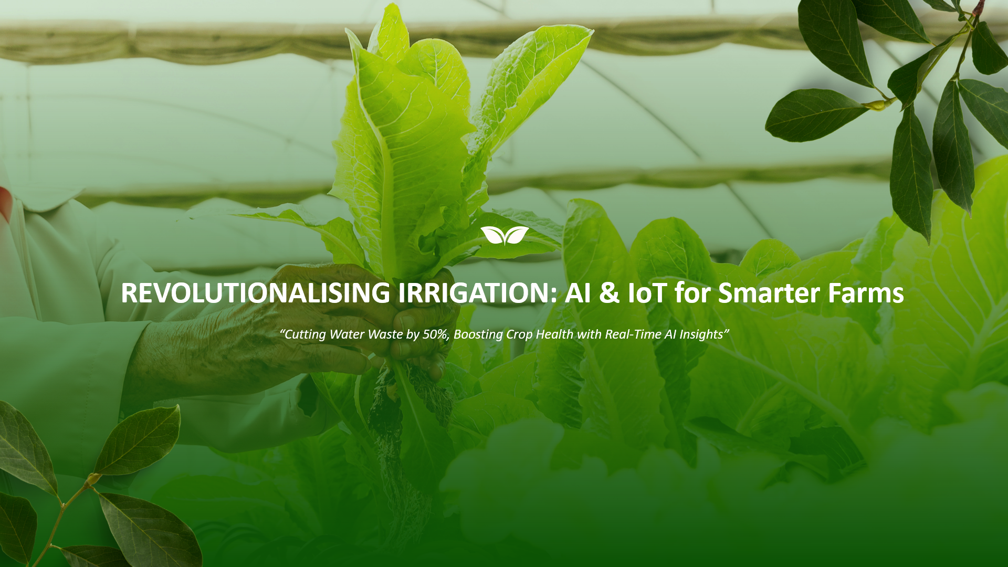

Leveraging AI for Precision Agriculture
This presentation explores how AI can optimize farming practices through data-driven insights and automated control.
by Vaishnavi Peddi

Slide 2
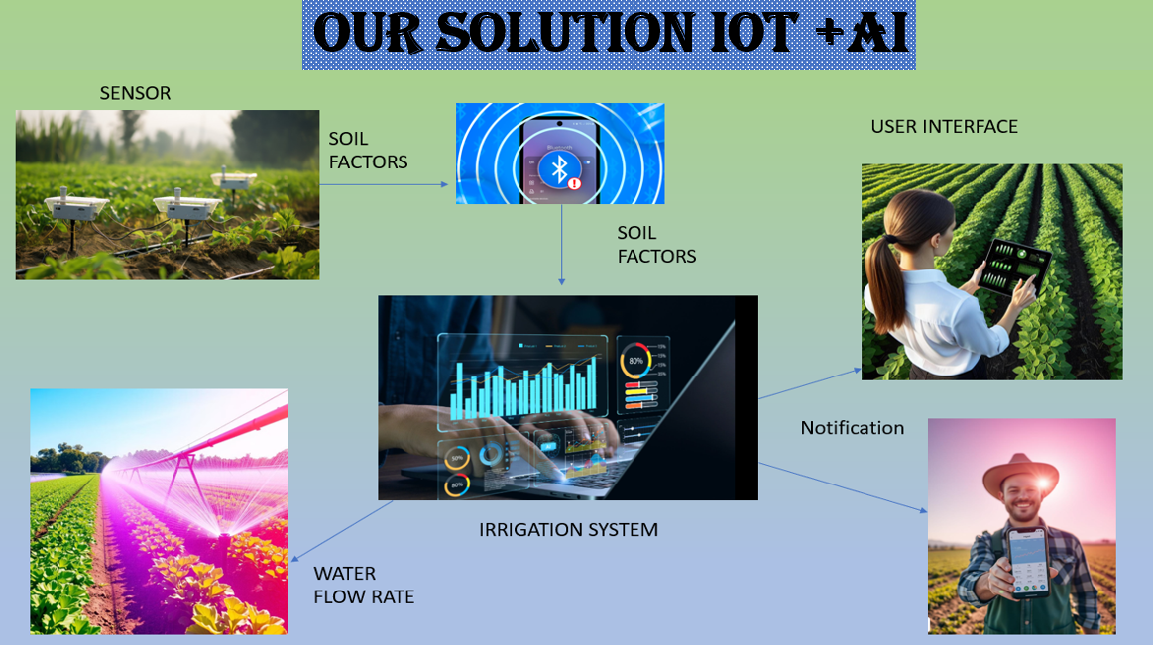

Slide 3
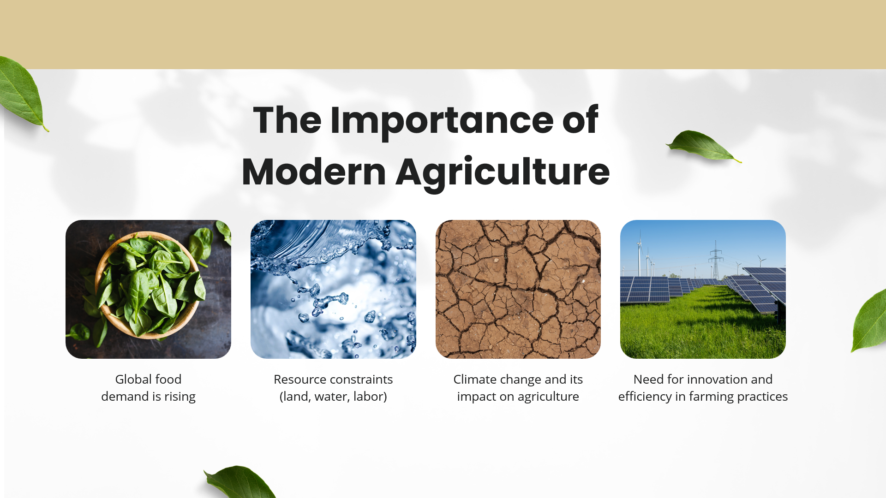
Challenges of Traditional Farming Practices
Manual Monitoring
Inefficient Resource Use
Farmers rely on visual inspection to assess soil moisture and crop health, which is time-consuming and subjective.
Traditional methods often lead to over-irrigation or under-fertilization, wasting resources and harming the environment.

Slide 4
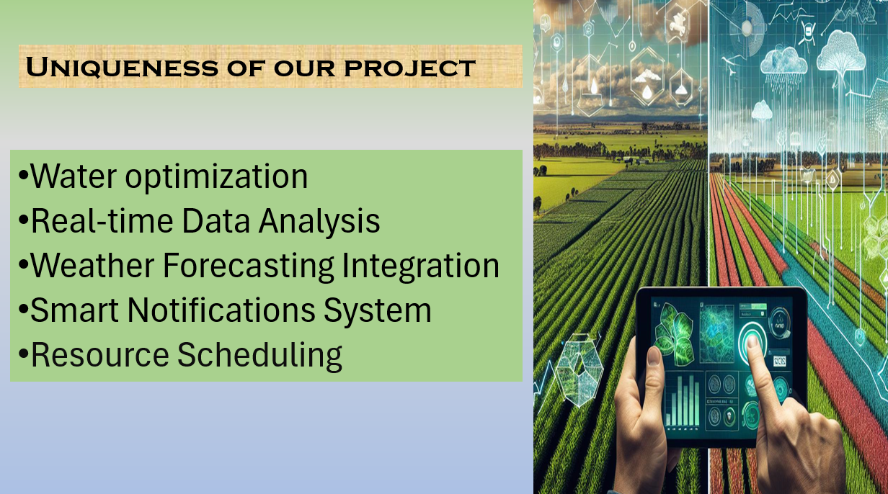

Slide 5
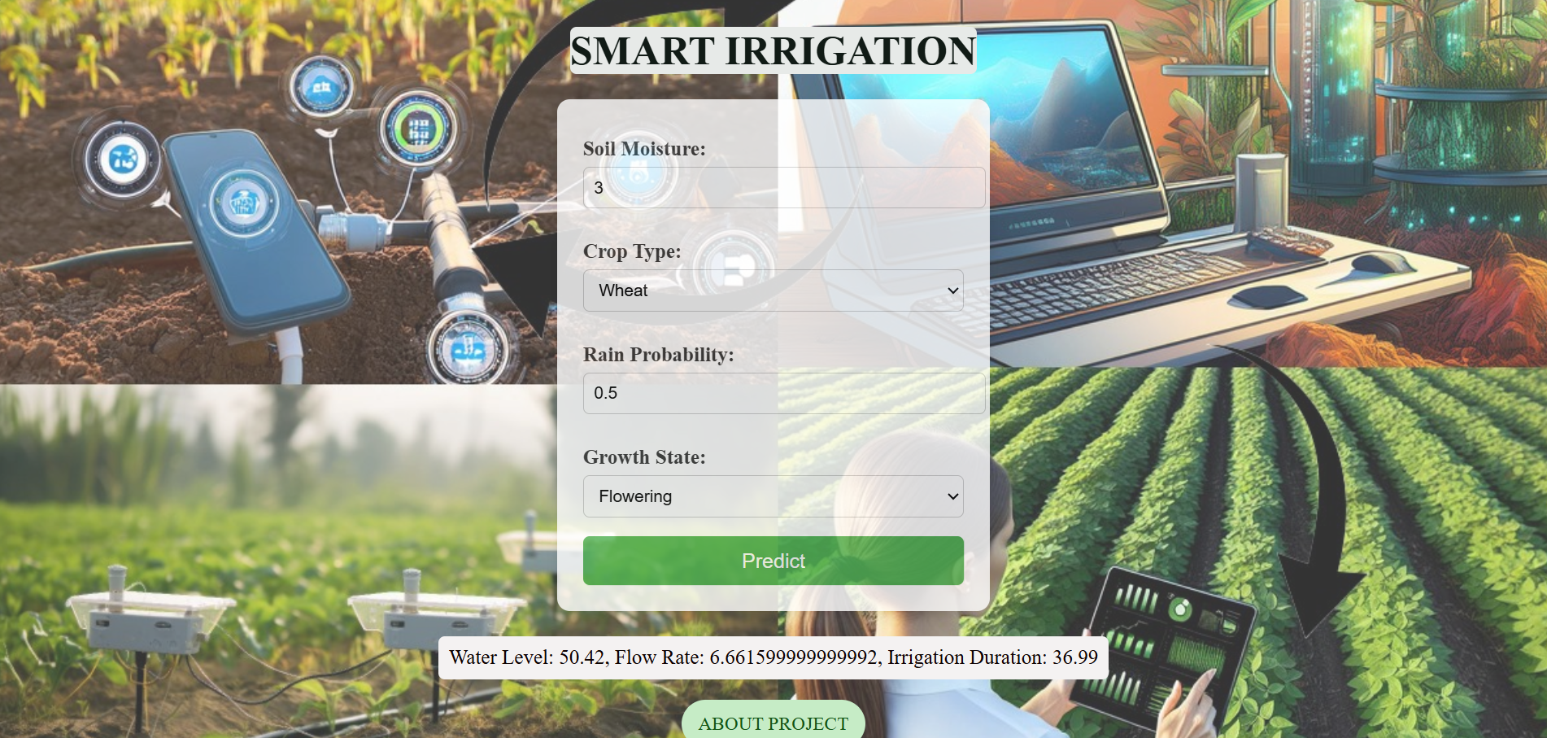
PROTOTYPE
SENSOR INPUTS
SENSOR INPUTS
WATER LEVELS

Slide 6
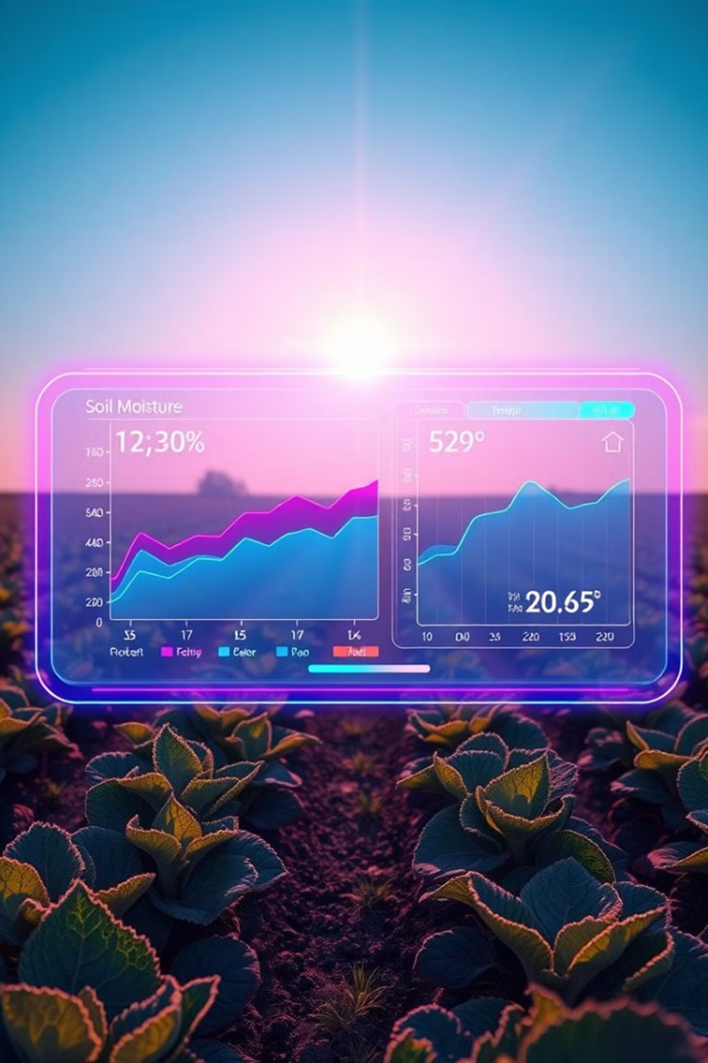

Importance of Soil Moisture and Crop Health Monitoring
1
Optimal Growth Conditions
2
Early Detection of Problems
Accurate monitoring ensures crops receive the right amount of water and nutrients, promoting healthy growth.
Real-time data allows farmers to identify issues like pests, diseases, or nutrient deficiencies early on.

Slide 7
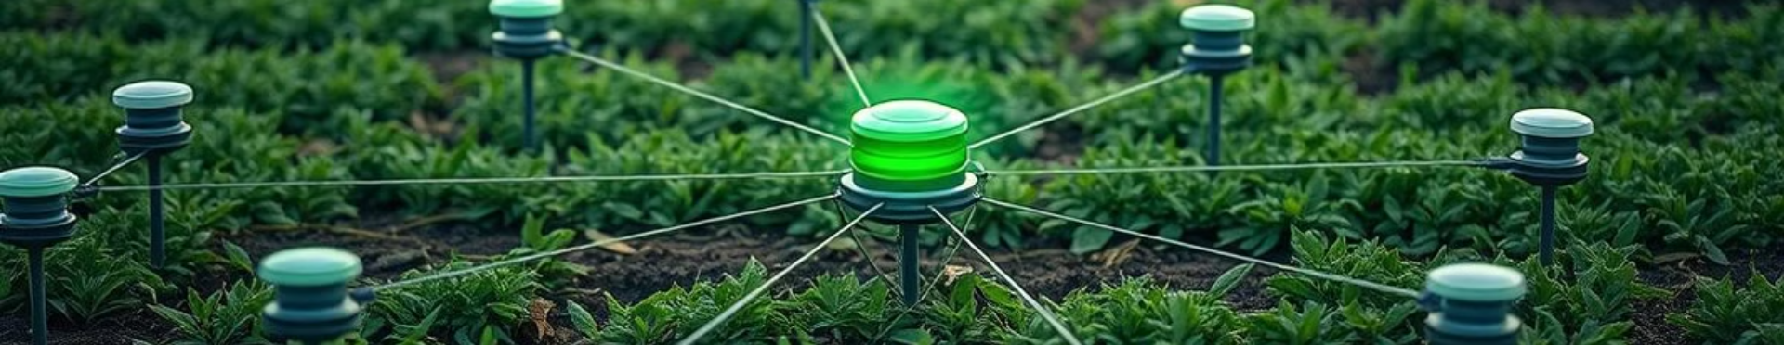
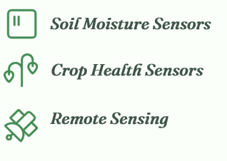
TECH STACK
AI-Powered Sensor System: Design and Components
Flask
Machine Learning Algorithm—Random Forest Regression
AI – Analytics
Weather API integration

Slide 8
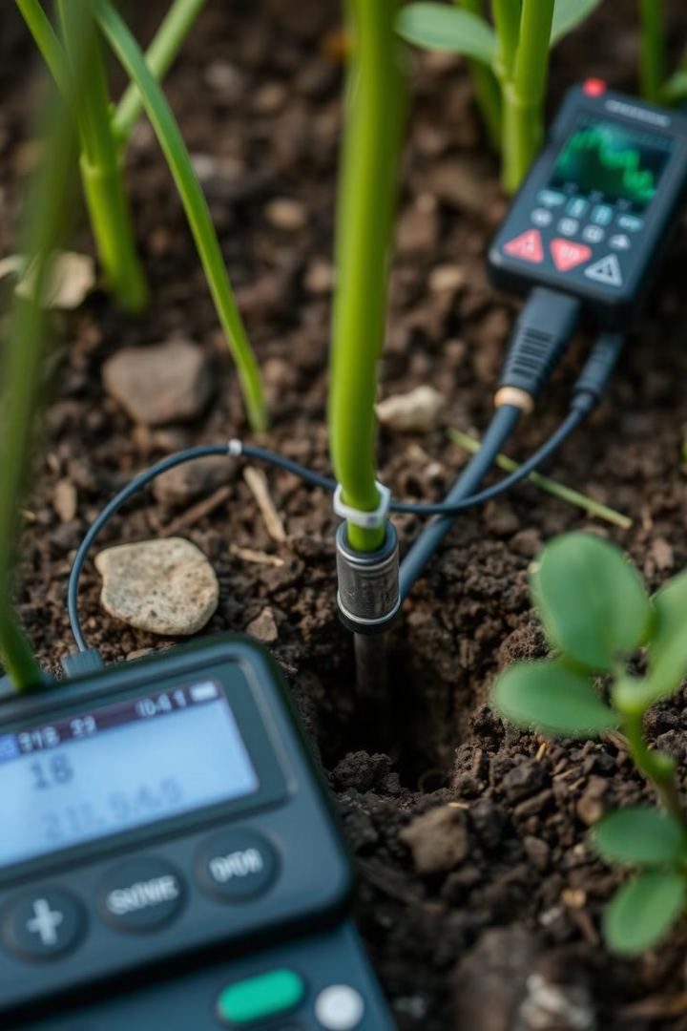
Soil Moisture and Nutrient Sensing
1
Sensor Placement
Sensors are strategically placed throughout the field to capture diverse moisture conditions.
2
Data Collection and Analysis
Sensors collect data on moisture levels, temperature, and other parameters, which is then analyzed using AI algorithms.
3
Irrigation Optimization
The system recommends precise irrigation schedules based on real-time soil moisture data, minimizing water waste.

Slide 9
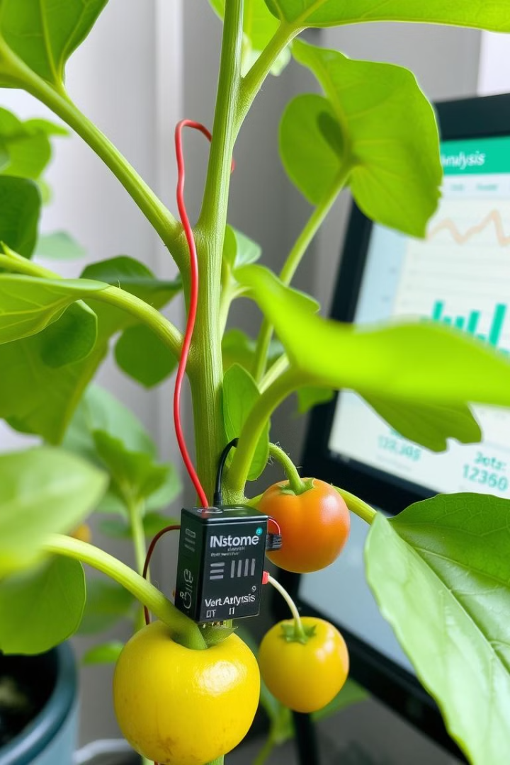



Crop Health Monitoring and Analysis
Disease and Pest Detection
Sensors detect changes in plant physiology, allowing for early detection of disease or pest infestations.
Nutrient Deficiency Analysis
The system identifies nutrient deficiencies based on plant growth and chlorophyll readings.
Growth Stage Monitoring
The system tracks plant growth stages, providing insights into crop development.

Slide 10
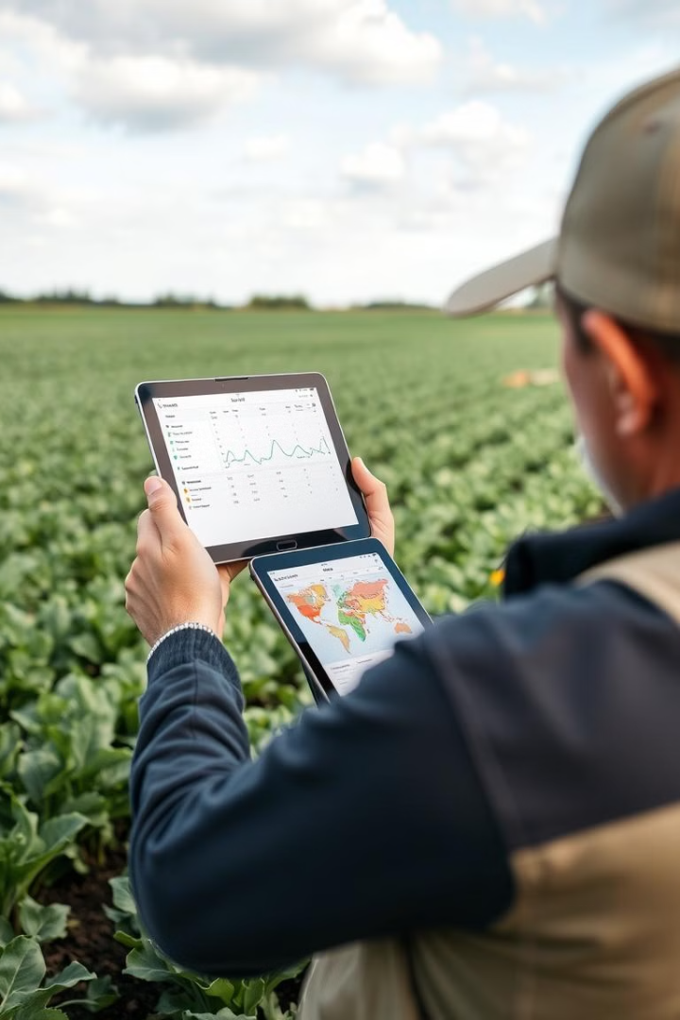
Data-Driven Recommendations for Irrigation and Fertilization
1
2
Irrigation
Fertilization
Tailored watering schedules based on soil moisture and crop demand.
Recommended nutrient applications based on plant health and soil analysis.

Slide 11
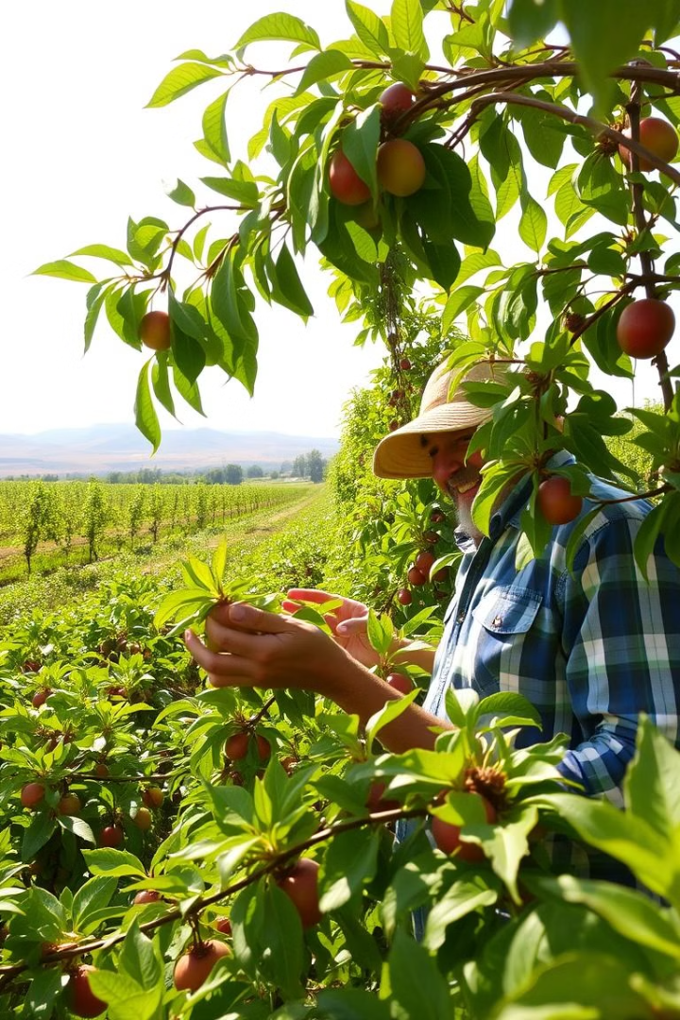
Improving Yields and Reducing Operational Costs
The AI-powered sensor system enables farmers to optimize resource utilization, increase crop yields, and minimize environmental impact.

Slide 12


